Slide 1
Lab Exercise: 5
Developing Best first search and A*Algorithm for real world problems

Slide 2
Best First Search

Slide 3
Best First Search
The idea of Best First Search is to use an evaluation function to decide which adjacent is most promising and then explore.
Best First Search falls under the category of Heuristic Search or Informed Search.
We use a priority queue to store costs of nodes.
So the implementation is a variation of BFS, we just need to change Queue to Priority Queue.
We are determining the optimal path between two cities using best first search.

Slide 4
Algorithm
Step 1 : Create a priorityQueue pqueue.
Step 2 : insert ‘start’ in pqueue : pqueue.insert(start)
Step 3 : delete all elements of pqueue one by one.
Step 3.1 : if, the element is goal . Exit.
Step 3.2 : else, traverse neighbours and mark the node examined.
Step 4 : End.

Slide 5
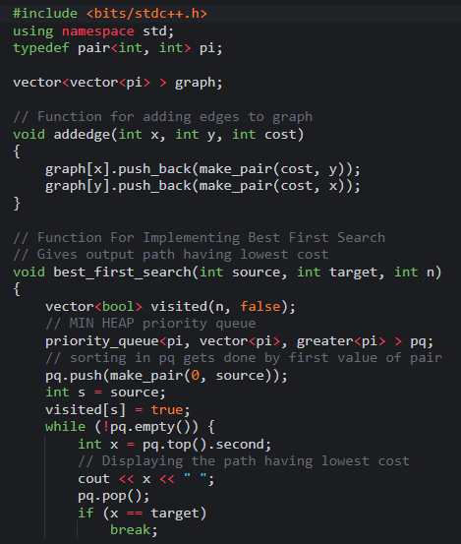
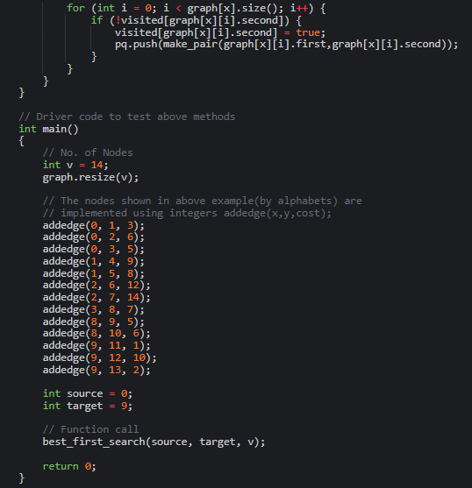
Code

Slide 6
Code
Output:

Slide 7
A* Algorithm

Slide 8
A* Algorithm
A* Search algorithm is one of the best and popular technique used in path-finding and graph traversals.
A* Search algorithms, unlike other traversal techniques, is really a smart algorithm which separates it from the other conventional algorithms.
To approximate the shortest path in real-life situations, like- in maps, games this algorithm can be used.
What A* Search Algorithm does is that at each step it picks the node according to a value-‘f’ which is a parameter equal to the sum of two other parameters – ‘g’ and ‘h’. At each step it picks the node/cell having the lowest ‘f’, and process that node/cell.

Slide 9
A* Algorithm
If f(n) represents the final cost, then it can be denoted as:
f(n) = g(n) + h(n)
where:
g(n) = cost of traversing from one node to another.
This will vary from node-to-node
h(n) = heuristic approximation of the node's value.
This is not a real value but an approximation cost

Slide 10
Algorithm
Add start node to list
For all the neighbouring nodes, find the least cost F node
Switch to the closed list
For 8 nodes adjacent to the current node
If the node is not reachable, ignore it. Else
If the node is not on the open list, move it to the open list and calculate f, g, h.
If the node is on the open list, check if the path it offers is less than the current path and change to it if it does so.
Stop working when
You find the destination
You cannot find the destination going through all possible points

Slide 11
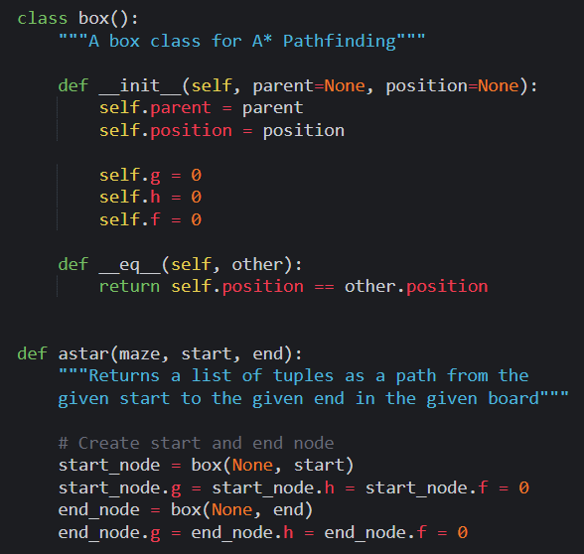
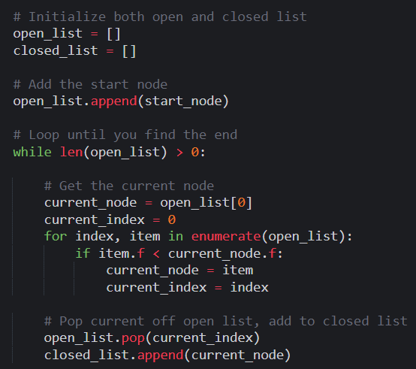
Code

Slide 12
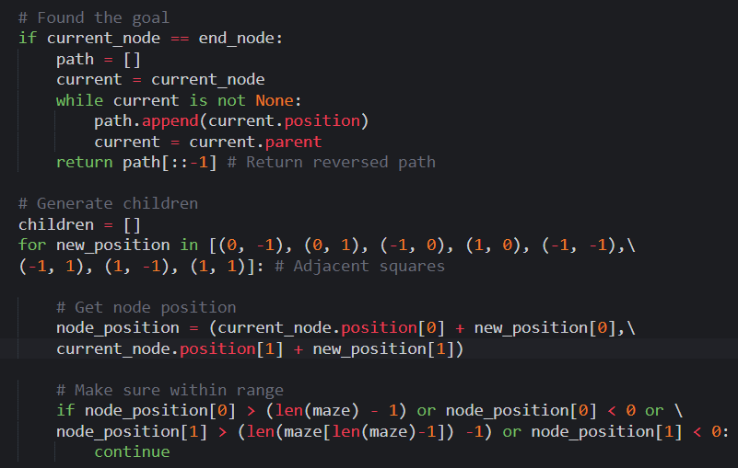
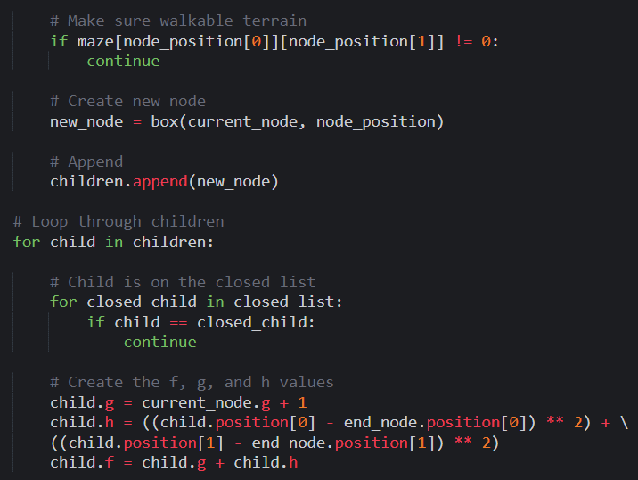
Code

Slide 13
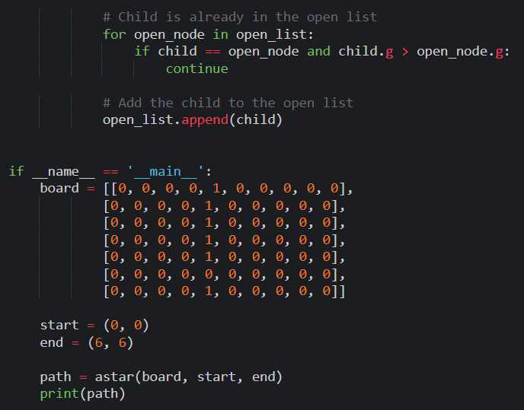
Code

Slide 14
Code
Output:

Slide 15
Thank You
VIVEK BURUGUDDA RA1911003010316
HARSHIL AGARWAL RA1911003010325
RITESH RAI RA1911003010333
PUNEET SHARMA RA1911003010331
PRAKHAR VIJAY RA1911003010337

